Slide 1
HOW DO YOU DEFINE THE WORD SUCCESS? WHAT MAKES SOMEONE SUCCESSFUL?

Slide 2
IT’S DIFFICULT TO PUT TOGETHER A DEFINITION OF SUCCESS WITHOUT USING THE WORD INCREASE

Slide 3
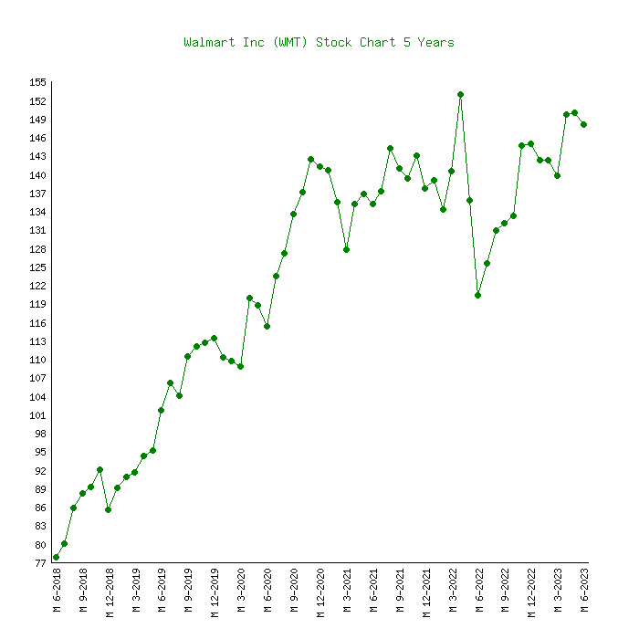
SUCCESS for a chief executive officer (CEO) – is an INCREASE in SALES

Slide 4
AN INCREASE IN PROFIT MARGIN

Slide 5
AN INCREASE in the SHARE PRICE of the company’s STOCK

Slide 6
AND A POSITIVE FORECAST for the NEXT QUARTER

Slide 7
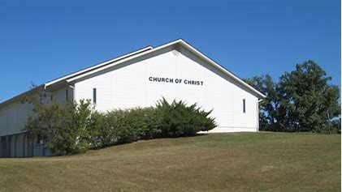
WHAT’S YOUR DEFINITION OF A SUCCESSFUL LOCAL CHURCH?

Slide 8
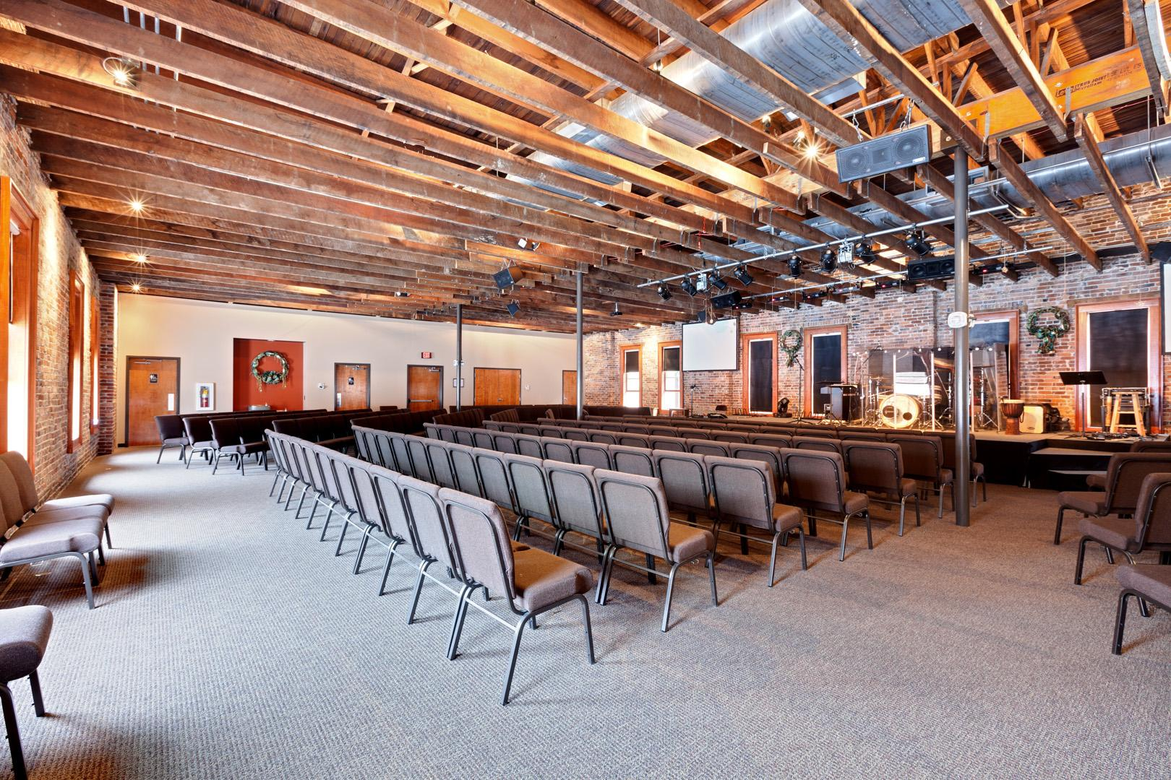
WE TEND TO THINK AN INCREASE IN MEMBERSHIP IS HOW SUCCESS IS MEASURED

Slide 9
IT’S FLAWED to only EQUATE SUCCESS with an INCREASE in ATTENDANCE

Slide 10
SOMETIMES AN INCREASE IN MEMBERSHIP DOES INDICATE POSITIVE THINGS

Slide 11
CONGREGATIONS CAN INCREASE THEIR MEMBERSHIP WITHOUT MUCH IF ANY EFFORT

Slide 12
So – JUDGING A CONGREGATION as SUCCESSFUL BASED SOLELY on an INCREASE IN ATTENDANCE can be FLAWED

Slide 13
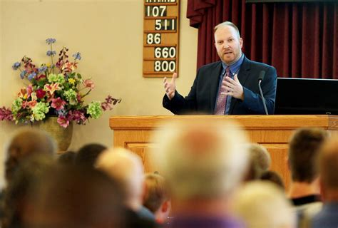
IT’S ALSO FLAWED TO JUDGE THE SUCCESS OF A PREACHER – SOLELY ON THE NUMERICAL GROWTH OF THE CONGREGATION

Slide 14
NONE OF THIS IS INTENDED TO BE NEGATIVE TOWARD AN INCREASE IN ATTENDANCE

Slide 15
MY INTENT IS TO CAUSE US TO THINK ABOUT THINGS IMOPORTANT FOR EVERY LOCAL CONGREGATION

Slide 16
JESUS WOULD HAVE US TO GO INTO ALL THE WORLD AND MAKE DISCIPLES MATTHEW 28

Slide 17
IF WE TEACH AND PREACH THE GOSPEL THERE WILL BE AN INCREASE IN THE NUMBER OF DISCIPLES

Slide 18
AN INCREASE MEMBERSHIP IS A GOOD THING BECAUSE SOULS ARE BEING ADDED TO THE SAVED

Slide 19
HOWEVER – THERE ARE IMPORTANT TRUTHS THAT WE NEED TO BE REMINDED OF

Slide 20
I. ONLY GOD CAN GIVE THE INCREASE

Slide 21
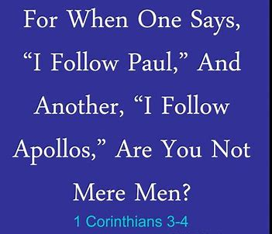
THE CHRISTIANS AT CORINTH EXPERIENCED SOME STRIFE – DIVISION AND FACTIONS

Slide 22
SOME ALIGNED THEMSELVES WITH PAUL - LIKELY BECAUSE HE WAS AN APOSTLE

Slide 23
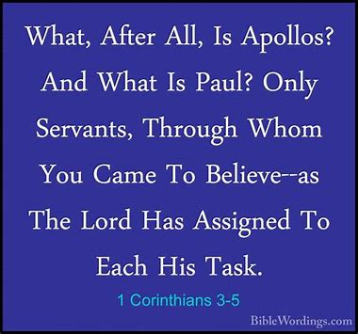
OTHERS ALIGNED WITH APOLLOS - LIKELY DUE TO HIS SPEAKING ABILITY

Slide 24
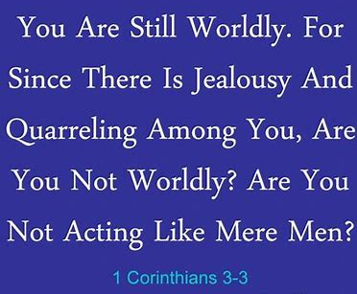
PAUL ACCUSED THEM OF BEING CARNAL or WORLDLY in THEIR THINKING

Slide 25
WHILE IT’S TRUE THAT SOME TEACHERS AND PREACHERS ARE VERY TALENTED

Slide 26
GOD DOESN’T GIVE THE INCREASE – BASED UPON SONEONE’S ABILITY TO KEEP AN AUDIENCE CAPTIVE

Slide 27
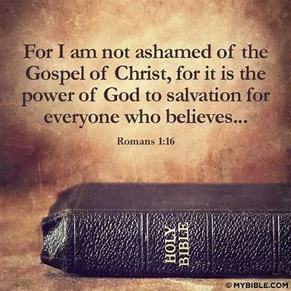
II. THE GOSPEL OF CHRIST IS THE POWER OF GOD UNTO SALVATION

Slide 28
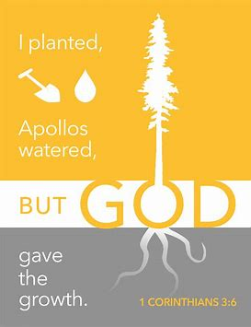
JAMES CALLED IT “the engrafted word which is able to save our soul” James 1.21

Slide 29
The SEED – WHICH IS THE WORD OF GOD MUST be PLANTED - or SOWN

Slide 30
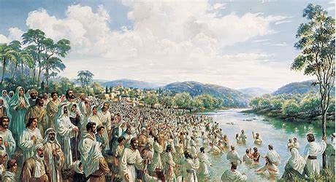
ON THE DAY OF PENTECOST THERE WERE 3,000 PRECIOUS SOULS ADDED- ACTS 2.41

Slide 31
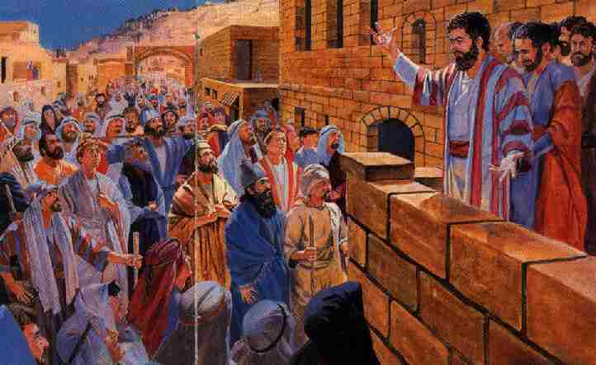
WHILE 3,000 BAPTISMS is GREAT – [most suggest] THAT there were 1-MILLION+ WHO HEARD on that day

Slide 32
WHY WEREN’T THERE MORE THAN THE 3,000 WHO WERE BAPTIZED?

Slide 33
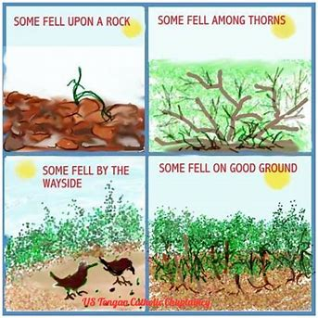
THE PARABLE OF THE SOWER – PROVIDES US WITH IMPORTANT ANSWERS MATTHEW 13.18-23

Slide 34
THERE ARE DIFFERENT SOILS [hearts] and not every HEART WILL GLADLY RECEIVE THE WORD

Slide 35
1ST - IS THE WAYSIDE SOIL [v. 19] THIS SOIL [HEART] IS TOO HARD FOR THE SEED TO PENETRATE

Slide 36
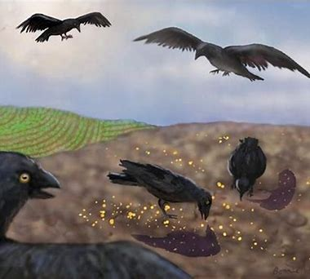
THE DEVIL [represented by the birds] SWOOPS DOWN AND EATS THE SEED

Slide 37
REMEMBER – WITHOUT THE WORD - GOD WON’T GIVE THE INCREASE

Slide 38
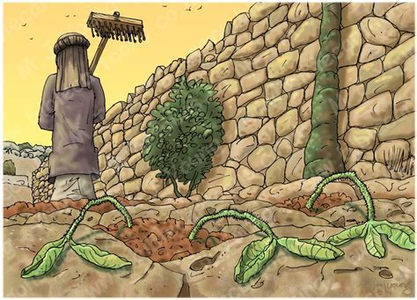
A SECOND KIND OF SOIL [HEART] IS called - STONY SOIL [13.20-21]

Slide 39
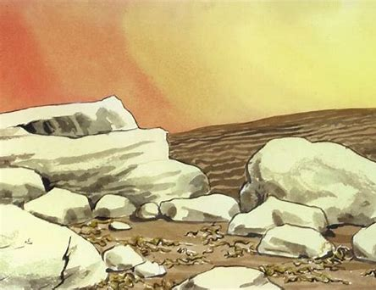
WHILE THIS PICTURE MAY BE AN ACCURATE DEPICTION OF THIS SOIL IN SOME INSTANCES

Slide 40
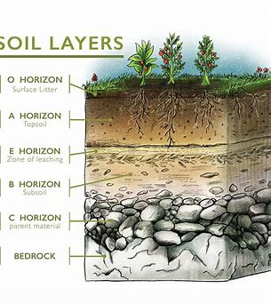
THE MORE ACCURATE PICTURE IS LIKELY THIS ONE OF - STONES UNDERNEATH A LAYER OF SOIL

Slide 41
SO - WHEN THE SEED IS PLANTED IT WILL GROW – BUT WITHOUT DEEP ROOTS THE PLANT WILL DIE

Slide 42
TRIBULATION and PERSECUTION along with OTHER PRESSURES in life REQUIRE DEEP ROOTS

Slide 43
WITHOUT DEEP ROOTS WE SIMPLY CANNOT SURVIVE THE HEAT etc.

Slide 44
The HEAT being TRIBULATION and PERSECUTION along with OTHER PRESSURES

Slide 45
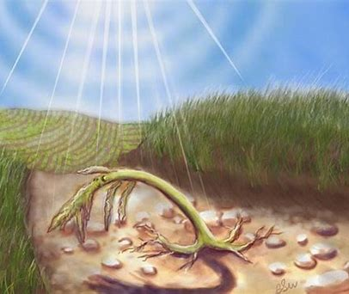
WHILE HEARING THE WORD AND GIVING AN IMMEDIATE EMOTIONAL RESPONSE IS GREAT – [v. 20] WITHOUT ROOTS it’s only TEMPORARY

Slide 46
A 3RD KIND OF SOIL IS A THORNY SOIL [13.22] that PICTURES A FIELD NOT ADEQUATELY CULTIVATED

Slide 47
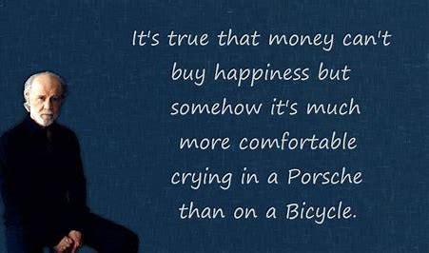
WEEDS ARE THINGS LIKE WORRY – ANXIETY – FINANCIAL CONCERNS and even the DECEITFULNESS OF RICHES – which can CHOKE OUT the WORD

Slide 48
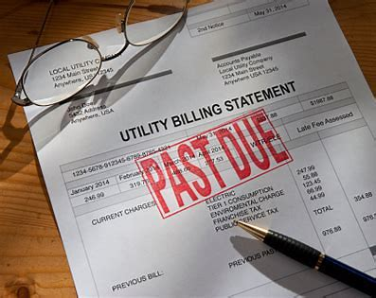
WHILE IT’S TRUE THAT WE NEED MONEY FOR GROCERIES – FOR RENT – CLOTHING – etc.

Slide 49
WHAT WE NEED IN OUR LIVES MORE THAN ANYTHING AND ANYONE IS JESUS CHRIST

Slide 50
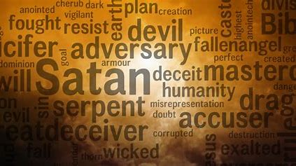
SATAN WILL USE EVERY WEED WITHIN HIS POWER TO CHOKE OUT THE WORD OF GOD

Slide 51
THE 4TH AND FINAL SOIL CAN SIMPLY BE REFERRED TO AS THE GOOD SOIL [13.23]

Slide 52
THE GOOD SOIL [heart] WELCOMES THE WORD AND OBEYS THE WORD

Slide 53
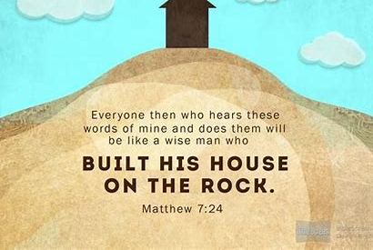
MUCH LIKE THE WISE MAN WHO BUILT HIS HOUSE UPON THE ROCK – MATTHEW 7.24-27

Slide 54
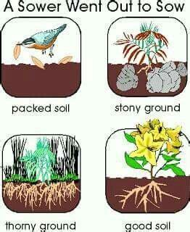
WHILE THE GOOD SOIL LIKELY ISN’T TOTALLY FREE OF STONES – THORNS or PATCHES OF HARD SOIL – THE WORD OF GOD IS ABLE TO GROW WITH DEEP ROOTS

Slide 55
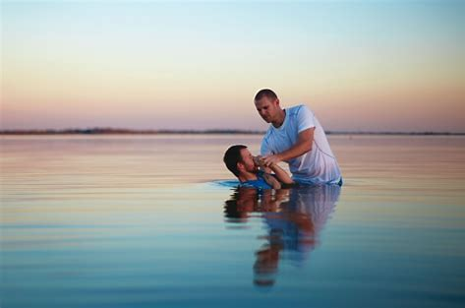
THOSE WHO GLADLY RECEIVED THE WORD WERE BAPTIZED – ACTS 2.41

Slide 56
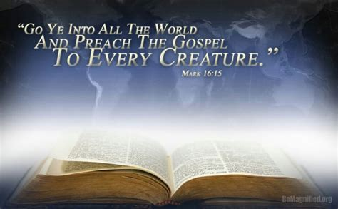
IT’S VITALLY IMPORTANT FOR US TO TAKE THE GOSPEL TO THE WORLD AND MAKE DISCIPLES

Slide 57
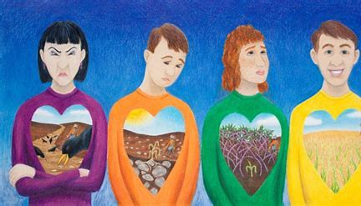
BUT - WE CAN’T CONTROL THE RESPONSE OF THOSE WE TEACH BECAUSE WE CAN’T CONTROL THEIR HEART

Slide 58
BUT WHAT WE CAN CONTROL IS OUR OWN PERSONAL GROWTH AND MATURITY AS CHRISTIANS

Slide 59
WHILE IT’S A DEGREE OF SUCCESS FOR A LOCAL CHURCH TO INCREASE IN NUMBER

Slide 60
INDIVIDUAL PERSONAL SPIRITUAL GROWTH IS VITAL IN MAKING A LOCAL CHURCH SUCCESSFUL

Slide 61
TO NEGLECT THE PERSONAL SPIRITUAL GROWTH OF EACH INDIVIDUAL CHRISTIAN IS A MISTAKE

Slide 62
WE ARE ADMONISHED IN SCRIPTURE TO GUARD OUR HEARTS

Slide 63
BUT – THE ONLY WAY WE CAN GUARD OUR HEART IS TO GO ON THE OFFENSIVE

Slide 64
GOING ON THE OFFENSIVE MEANS TO GROW AND INCREASE OUR FAITH

Slide 68
LET’S RETURN TO THE DAY OF PENTECOST AND MAKE A COUPLE OF BRIEF OBSERVATIONS

Slide 69
PAY CLOSE ATTENTION TO WHAT’S SAID IN ACTS 2.42-47 – WHAT DID THEY CONTINUE STEADFASTLY IN?

Slide 70
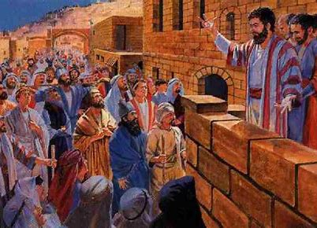
“And they continued steadfastly in the apostle’s doctrine, etc.” ACTS 2.42

Slide 71
YES – IT’S IMPORTANT TO GO MAKE DISCIPLES

Slide 72
BUT NOT TO THE POINT OF NEGLECTING TO GROW SPIRITUALLY AS INDIVIDUAL CHRISTIANS

Slide 73
- The Apostles did the preaching

Slide 74
THE WAYSIDE SOIL [v. 19] THE SOIL [heart] IS TOO HARD FOR THE SEED TO PENETRATE

Slide 75
- Apostles only spoke as the Holy Spirit gave them utterance

Slide 76
- The message (the seed) was exactly what was needed

Slide 77
- The apostles delivered the Spirit inspired message

Slide 78
- 3,000 repented and were baptized - Why only 3,000?

Slide 79
- Most suggest that more than -1-million may have been gathered

Slide 80
Parable of the Sower Matthew 13.18-23

Slide 82
2-SAMPE DEFINITIONS OF SUCCESS
SUCCESS - DEFINED
SUCCESS FOR A CEO
The accomplishment of an aim or purpose.
The attainment of fame – of wealth – or social status.
An increase in sales
Increased profit margin
A positive forecast for the next quarter
An increase in the stock share price
HOW DO YOU DEFINE SUCCESS?
HOW DO YOU DEFINE SUCCESS?

Slide 83
MATTHEW 10.5
Gentiles and Samaritans are here classed together since the latter were a mixed race - hostile to the Jews and had a false religion. John 4.22.
Do not go in the way of the Gentiles, and do not enter any city of the Samaritans.
HOW DO YOU DEFINE SUCCESS?

Slide 84
MATTHEW 10.5
Gentiles and Samaritans are here classed together since the latter were a mixed race - hostile to the Jews and had a false religion. John 4.22.
Do not go in the way of the Gentiles, and do not enter any city of the Samaritans.
THE LIMITED COMMISSION OF THE APOSTLES

Slide 85
MATTHEW 10.5
Gentiles and Samaritans are here classed together since the latter were a mixed race - hostile to the Jews and had a false religion. John 4.22.
Do not go in the way of the Gentiles, and do not enter any city of the Samaritans.
THE LIMITED COMMISSION OF THE APOSTLES

Slide 86
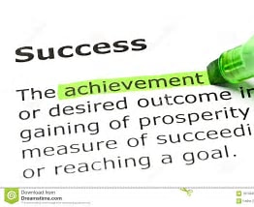
HOW DO YOU DEFINE SUCCESS?
NOT A BAD DEFINITION

Slide 87
What one considers as successful varies a great deal from one person to another. For some it means a good career, or earning a lot of money, or being famous in some way. For others it means living a happy life of their own choosing.

Slide 88
What one considers as successful varies a great deal from one person to another. For some it means a good career, or earning a lot of money, or being famous in some way. For others it means living a happy life of their own choosing.

Slide 89
IT’S FLAWED TO JUDGE A PREACHER BY ATTENDANCE NUMBERS

