Slide 1
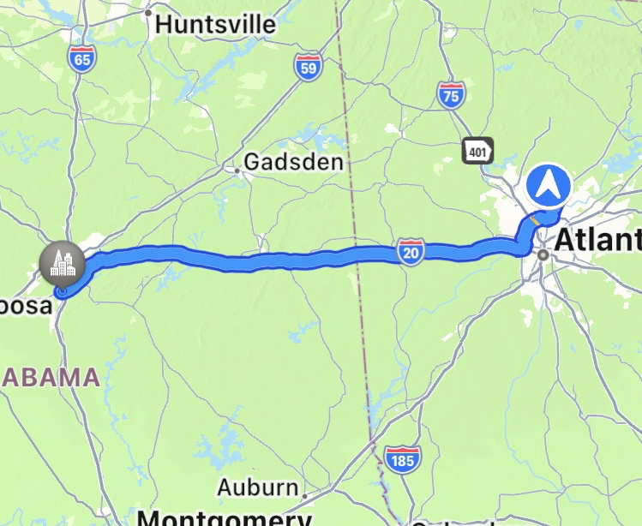
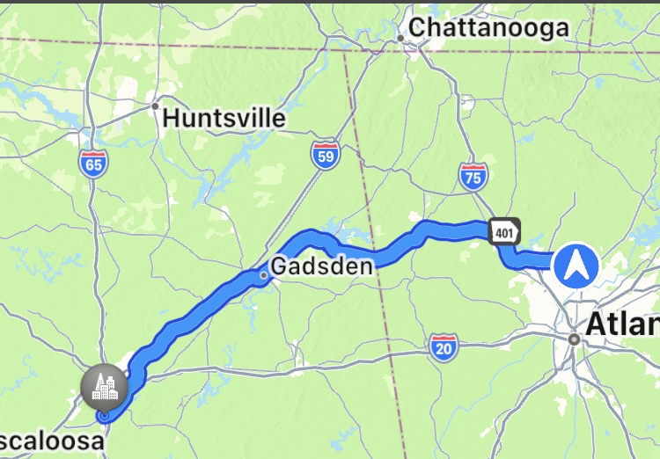

Slide 3
“13 Enter through the narrow gate; for the gate is wide and the way is broad that leads to destruction, and there are many who enter through it. 14 For the gate is small and the way is narrow that leads to life, and there are few who find it.”
Matthew 7:13-14

Slide 4
The Components:
Two Gates
Two Paths
Confining
Isolating
“13 Enter through the narrow gate; for the gate is wide and the way is broad that leads to destruction, and there are many who enter through it. 14 For the gate is small and the way is narrow that leads to life, and there are few who find it.”
Matthew 7:13-14

Slide 5
The Components:
Two Gates
Two Groups
Two Paths
Two Destinations
“13 Enter through the narrow gate; for the gate is wide and the way is broad that leads to destruction, and there are many who enter through it. 14 For the gate is small and the way is narrow that leads to life, and there are few who find it.”
Matthew 7:13-14

Slide 6
Implications & Applications:
Know You Will Often Stand Alone
Know You & Others Will Often Struggle
Know It’s Worth It In The End
“13 Enter through the narrow gate; for the gate is wide and the way is broad that leads to destruction, and there are many who enter through it. 14 For the gate is small and the way is narrow that leads to life, and there are few who find it.”
Matthew 7:13-14

