Slide 1
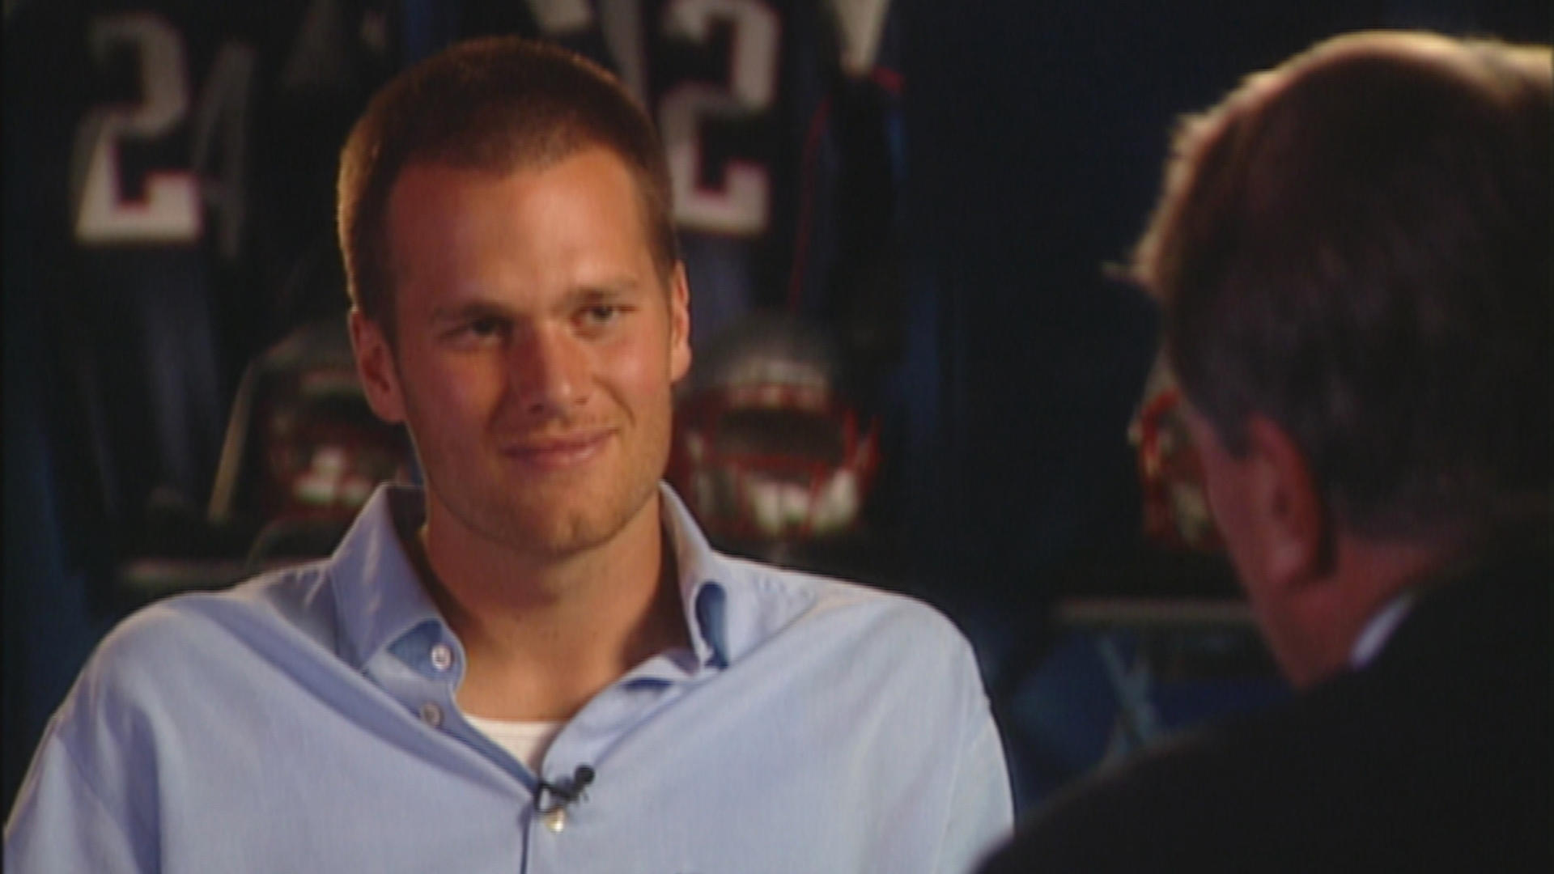
“Why do I have three Super Bowl rings and still think there's something greater out there for me? I mean, maybe a lot of people would say, 'Hey man, this is what is.' I reached my goal, my dream, my life. I think, 'It’s got to be more than this.' I mean this isn't, this can't be what it's all cracked up to be. I love playing football and I love being quarterback for this team. But at the same time, I think there are a lot of other parts about me that I'm trying to find.”
-Tom Brady (2005)

Slide 3
The Book of Ecclesiastes
Four Realities Of Earthly Riches:
It Will Never Bring Ultimate Satisfaction
“I enlarged my works: I built houses for myself, I planted vineyards for myself; 5 I made gardens and parks for myself and I planted in them all kinds of fruit trees; 6 I made ponds of water for myself from which to irrigate a forest of growing trees. 7 I bought male and female slaves and I had homeborn slaves. Also, I possessed flocks and herds larger than all who preceded me in Jerusalem.8 Also, I collected for myself silver and gold and the treasure of kings and provinces. I provided for myself male and female singers and the pleasures of men—many concubines ”
Ecclesiastes 2:4-8
“9 Then I became great and increased more than all who preceded me in Jerusalem. My wisdom also stood by me. 10 All that my eyes desired I did not refuse them. I did not withhold my heart from any pleasure, for my heart was pleased because of all my labor and this was my reward for all my labor.11 Thus I considered all my activities which my hands had done and the labor which I had exerted, and behold all was vanity and striving after wind and there was no profit under the sun.”
Ecclesiastes 2:9-11
“He who loves money will not be satisfied with money, nor he who loves abundance with its income. This too is vanity. 11 When good things increase, those who consume them increase. So what is the advantage to their owners except to look on?.”
Ecclesiastes 5:10-11
“I, the Preacher, have been king over Israel in Jerusalem ”
Ecclesiastes 1:12

Slide 4
The Book of Ecclesiastes
Four Realities Of Earthly Riches:
It Will Not Come With You When You Die
“18 Thus I hated all the fruit of my labor for which I had labored under the sun, for I must leave it to the man who will come after me. 19 And who knows whether he will be a wise man or a fool? Yet he will have control over all the fruit of my labor for which I have labored by acting wisely under the sun. This too is vanity.”
Ecclesiastes 2:18-19
“There is an appointed time for everything. And there is a time for every event under heaven—2 A time to give birth and a time to die.”
Ecclesiastes 3:1

Slide 5
The Book of Ecclesiastes
Four Realities Of Earthly Riches:
It Often Produces More Problems Than Solutions
“12 The sleep of the working man is pleasant, whether he eats little or much; but the full stomach of the rich man does not allow him to sleep. 13 There is a grievous evil which I have seen under the sun: riches being hoarded by their owner to his hurt. 14 When those riches were lost through a bad investment and he had fathered a son, then there was nothing to support him. 15 As he had come naked from his mother’s womb, so will he return as he came. He will take nothing from the fruit of his labor that he can carry in his hand. 16 This also is a grievous evil—exactly as a man is born, thus will he die. So what is the advantage to him who toils for the wind?”
Ecclesiastes 5:12-16

Slide 6
The Book of Ecclesiastes
Four Realities Of Earthly Riches:
It Will All Come To An End, It's Just A Matter Of Time
“6 Remember Him before the silver cord is broken and the golden bowl is crushed, the pitcher by the well is shattered and the wheel at the cistern is crushed.”
Ecclesiastes 12:6

Slide 7
Why Should We Take His Word?
God’s Word Supports These Realities
Our Observations Supports These Realities
“As for the rich in this present age, charge them not to be haughty, nor to set their hopes on the uncertainty of riches, but on God, who richly provides us with everything to enjoy.”
1 Timothy 6:17
“Do not lay up for yourselves treasures on earth, where moth and rust destroy and where thieves break in and steal….”
Matthew 6;19
“For the love of money is a root of all kinds of evils. It is through this craving that some have wandered away from the faith and pierced themselves with many pangs.”
1 Timothy 6:10
“Riches do not profit in the day of wrath, but righteousness delivers from death.”
Proverbs 11:4

Slide 8
Four Realities Of Earthly Riches
Two Applications For Us:
Don’t Be Deceived By Earthly Riches
Don’t Choose The Wrong Master
“19 Furthermore, as for every man to whom God has given riches and wealth, He has also empowered him to eat from them and to receive his reward and rejoice in his labor; this is the gift of God. 20 For he will not often consider the years of his life, because God keeps him occupied with the gladness of his heart .”
Ecclesiastes 5:19-20
“No one can serve two masters. Either you will hate the one and love the other, or you will be devoted to the one and despise the other. You cannot serve both God and money.”
Matthew 6:24

