Slide 2
“The Parable Of Weeds & Wheat”
Contextual Application
It’s Okay As A Disciple of Jesus To Ask Questions
“Make your ear attentive to wisdom, incline your heart to understanding, cry out for insight, raise your voice for understanding, seek it like silver, and search for it as for hidden treasures. Then, you will understand the fear of the Lord, and find the knowledge of God.”
Proverbs 2:2-5

Slide 3
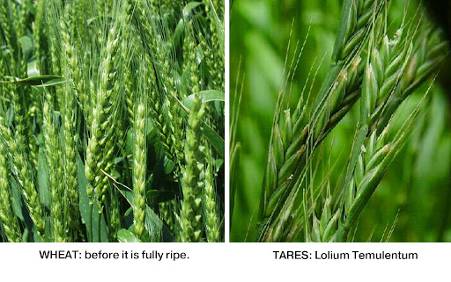

Slide 4
“The Parable Of Weeds & Wheat”
The Meaning & Application
Patience & Purpose
“Jesus makes clear that we simply cannot be certain who is “in” or who is “out.” In fact, God’s judgment about these matters will take many by surprise (7:21-23; 8:11-12; 21:31-32; 25:31-46). Thank God it is not up to us! We can leave the weeding to the angels, and get on with the mission Jesus has given us — proclaiming the good news of the kingdom of God drawing near .”
“Yet the point is clear, both in the world and in the kingdom community. Ultimately it is not the job of the church to weed out those who appear to be Christians but actually are not; that is God’s job at the end of this age.”

