Slide 1
March 1-2-3, 2024

Slide 2
Friday night – Growing in Hope
Saturday night – Growing via Daily Bible Reading
Sunday class – Growing in Holiness
Sunday morning – Growing in Evangelism
Sunday evening – Growing in Peace of Mind

Slide 3
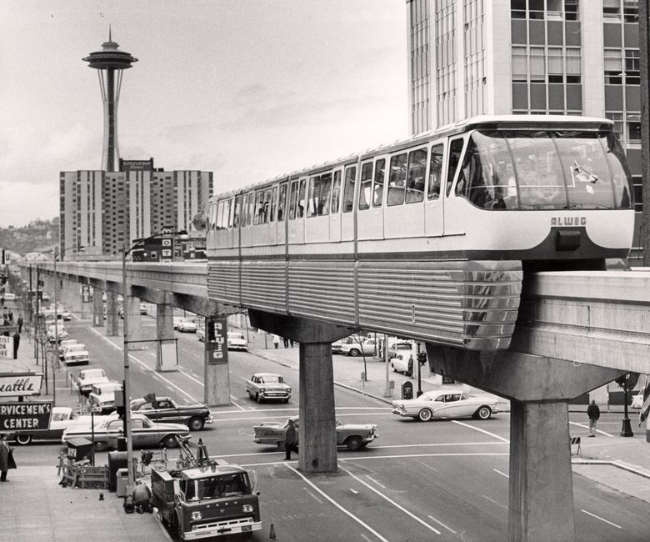

Slide 4
Growing in Hope

Slide 5
Growing in Hope
Hope is central to discipleship.

Slide 6
Growing in Hope
We don’t want false hopes.

Slide 7
“Because of ____________ I will be okay some day.”
What’s your hope?

Slide 8
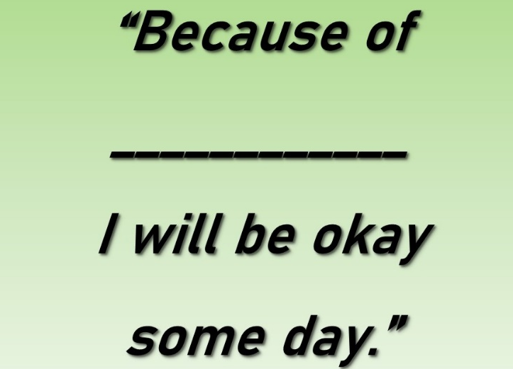
Growing in Hope
Embrace Christian hope.

Slide 9
Growing in Hope
Grab Christianity’s present hope.

Slide 10
Growing More Hope
Look to the horizon more.
Don’t let others kill your hope.
Be a hope sharer.
Read the Bible looking for hope.

Slide 11
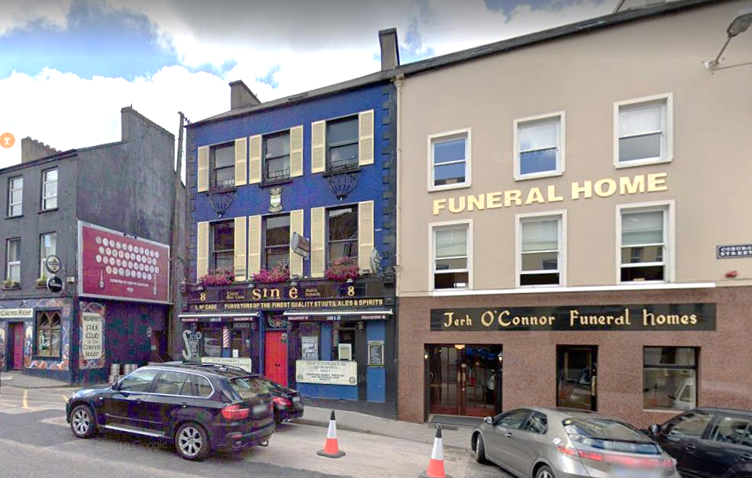

Slide 12
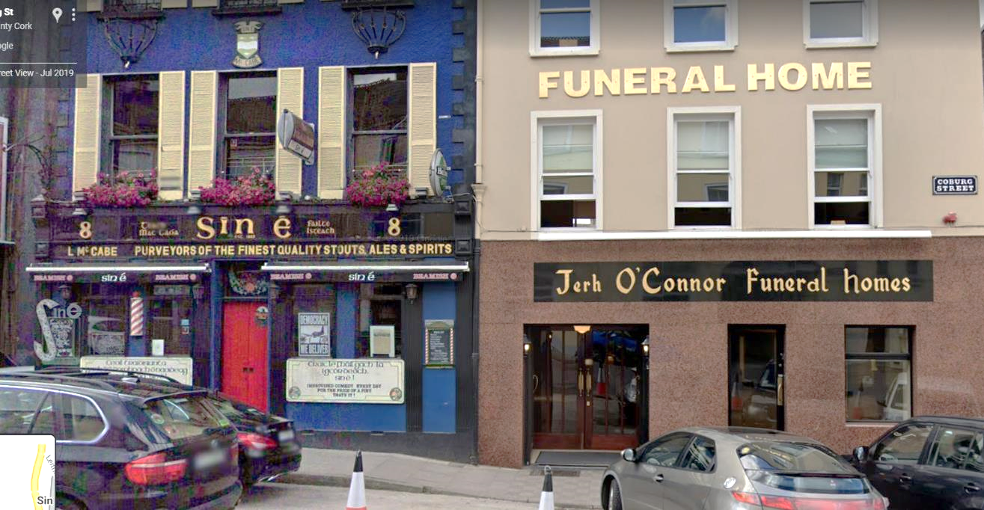

Slide 13
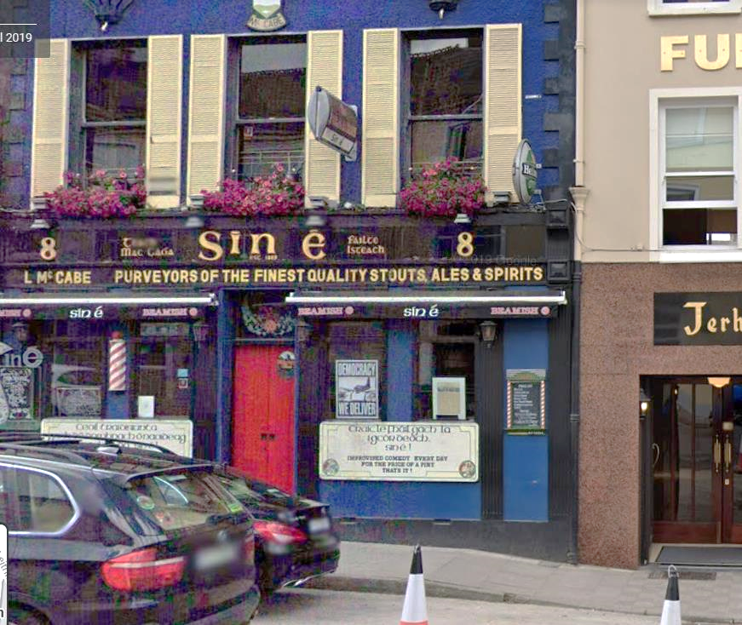

Slide 14
Growing in Hope

