Slide 1
March 1-2-3, 2024

Slide 2
Ready…Set…GROW!
Friday night – Growing in Hope
Saturday night – Growing via Daily Bible Reading
Sunday class – Growing in Holiness
Sunday morning – Growing in Evangelism
Sunday evening – Growing in Peace of Mind

Slide 3
Growing in Holiness

Slide 4
Why don’t we talk about holiness?
Holiness = bizarre and weird.

Slide 5
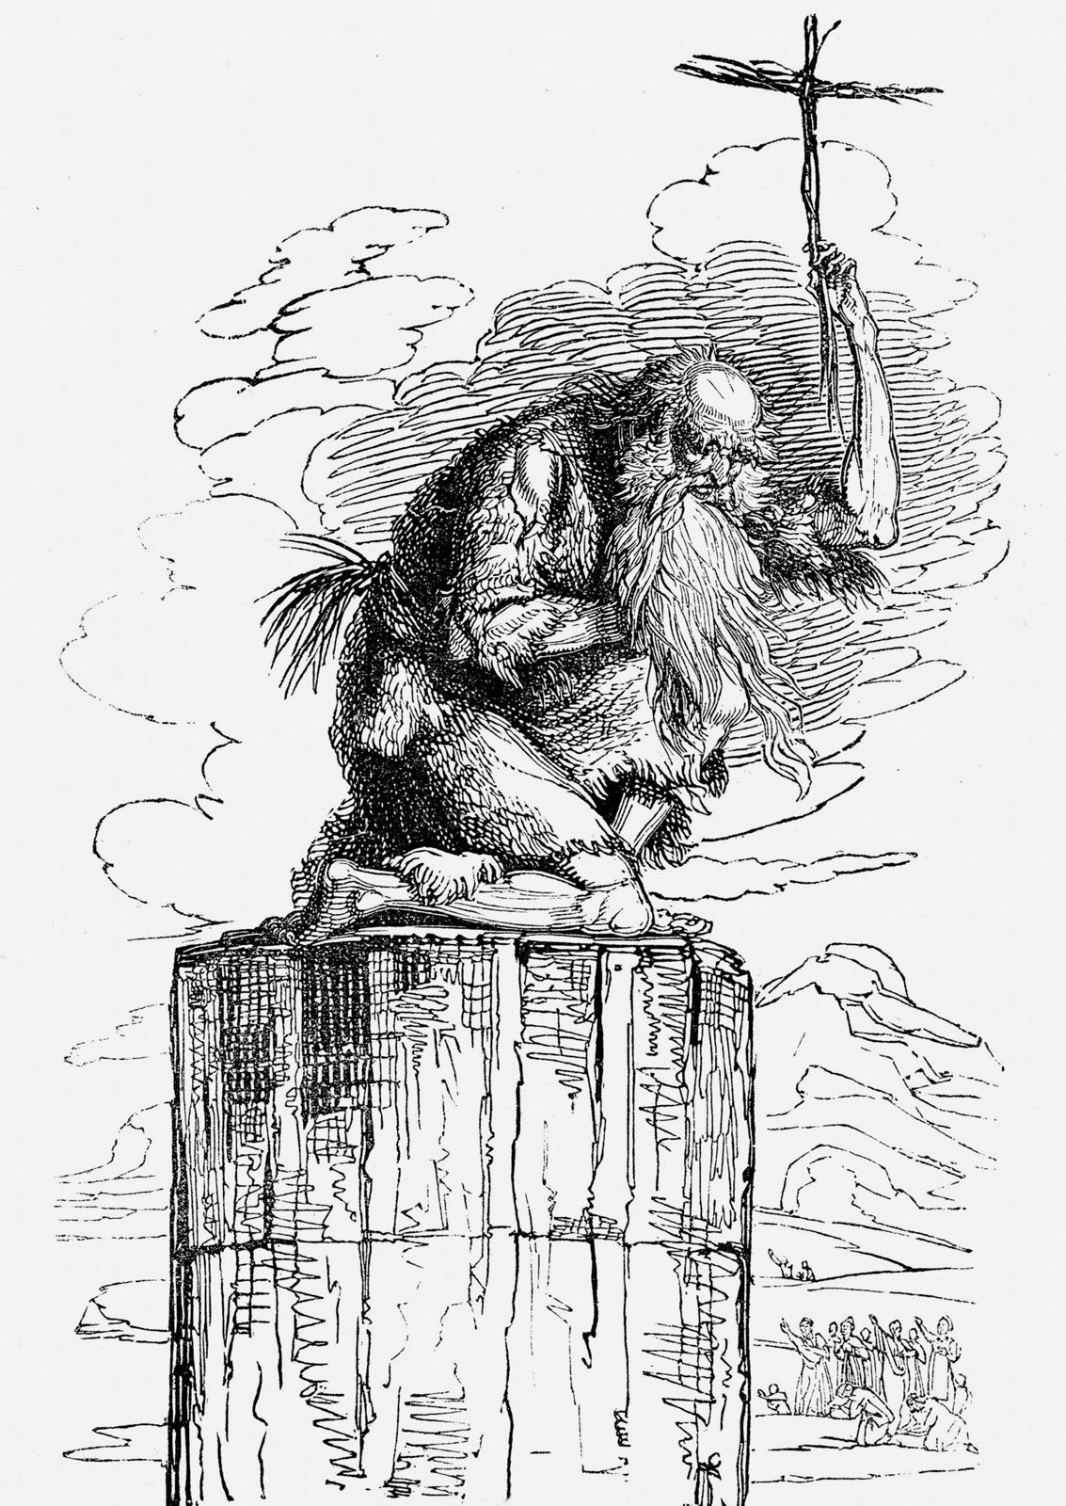
SIMEON STYLITES

Slide 6
Why don’t we talk about holiness?
Holiness = bizarre and weird.
Holiness means acting like you’re better than others.
Holiness is impossible.

Slide 7
Holiness is super important to God.
What we need to say about holiness

Slide 8
It means to be separate so we can be used by God.
What we need to say about holiness

Slide 9
SET APART
Guard against sexual sin.
Stop making yourself the exception.
Build holy relationships.
Ask “What is God doing around me?”
Worship.
USED BY GOD

Slide 11
Growing in Holiness

