Slide 1
March 1-2-3, 2024

Slide 2
Ready…Set…GROW!
Friday night – Growing in Hope
Saturday night – Growing via Daily Bible Reading
Sunday class – Growing in Holiness
Sunday morning – Growing in Evangelism
Sunday evening – Growing in Peace of Mind

Slide 3
Growing in Evangelism

Slide 4
STEP ONE: Recognize God doesn’t want everyone to be a missionary.
You can be a digital missionary!

Slide 5
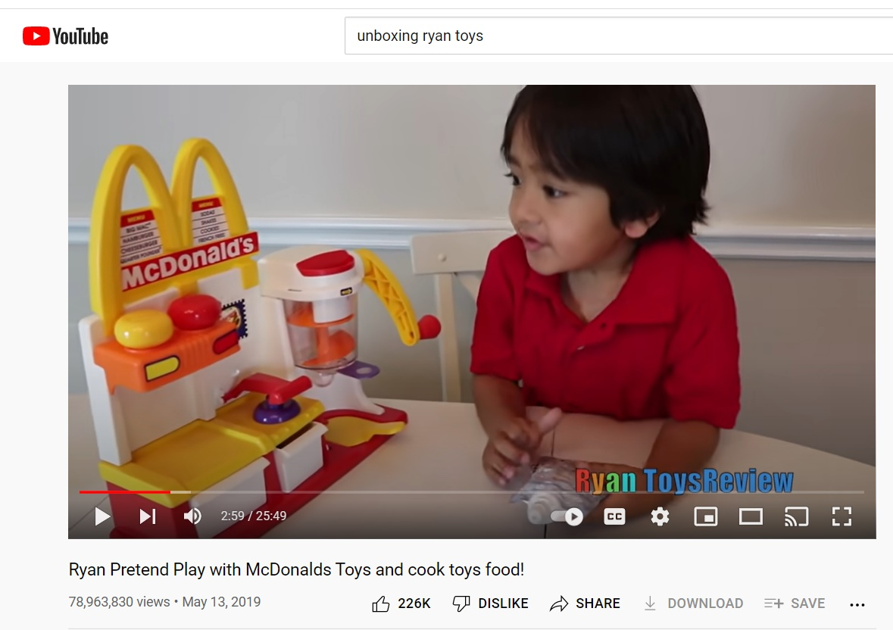

Slide 6
Social media usage
In 2008 10% of Americans had a social media account. Now 79% do.
88% of 18 to 29 year-olds have a social media account.
78% of 30 to 49 year-olds have a social media account.
69% of 50 to 64 year-olds are on social media, and even 40% of people over 65 have a social media account!

Slide 7
Social media usage
74% of people use Facebook every day. 72% of people use YouTube every day. 63% of people are on Instagram every day.

Slide 8
STEP ONE: Recognize God doesn’t want everyone to be a missionary but you can be an influence for the Kingdom.
STEP TWO: Think like a missionary.
You can be a digital missionary!

Slide 9
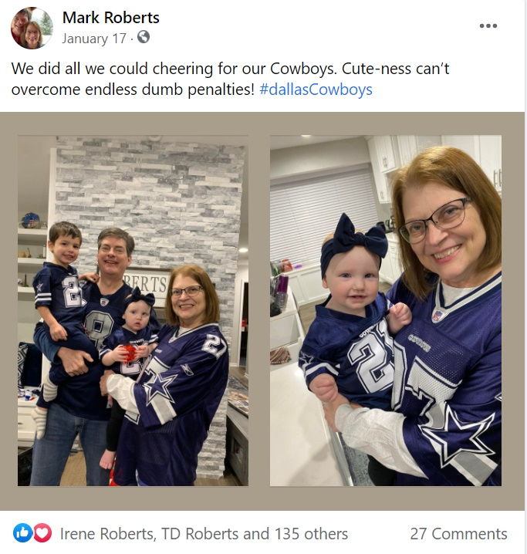
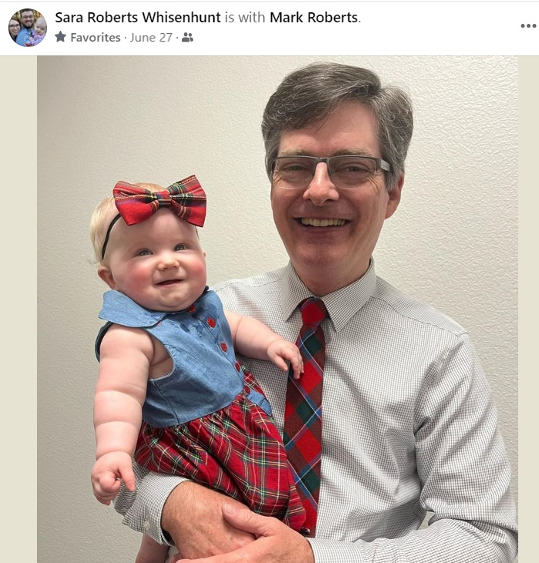

Slide 10
STEP ONE: Recognize God doesn’t want everyone to be a missionary but you can be an influence for the Kingdom.
STEP TWO: Think like a missionary.
STEP THREE: Post strategically.
You can be a digital missionary!

Slide 11
POST STRATEGICALLY
Nothing on my social can contradict my mission.
What can I post that will show I am a Christ-follower?
What can I post that will help people be more interested in being a Christ-follower?
How can I be a positive influence in a negative world?

Slide 12
STEP ONE: Recognize God doesn’t want everyone to be a missionary but you can be an influence for the Kingdom.
STEP TWO: Think like a missionary.
STEP THREE: Post strategically.
You can be a digital missionary!

Slide 13
Shorter is better.
Be genuine, be yourself.
Don’t judge or push people away.
Take arguments offline.
Get a picture.
Post a podcast.
Say something about class, sermon – link!
Get positive about church.
Talk daily Bible reading
Ask “how can I pray for you?”
Post Strategically

Slide 14
STEP ONE: Recognize God doesn’t want everyone to be a missionary but you can be an influence for the Kingdom.
STEP TWO: Think like a missionary.
STEP THREE: Post strategically.
You can be a digital missionary!

Slide 15
Growing in Evangelism

